Slide 1

Unlocking Value: Luxury Housing Analytics in Bengaluru
Presented by Deepak MStudying Data Science at GUVI

Slide 2
Problem & Approach: Bridging Data to Decisions
The Challenge
Our Solution
Building a robust, end-to-end analytics pipeline for Bengaluru's dynamic luxury housing market.
Data Engineering: Cleaned and transformed 100,000+ records using Python.
Database Integration: Structured data loaded into a scalable SQL database.
Interactive Insights: Developed live dashboards in Power BI for actionable intelligence.

Slide 3
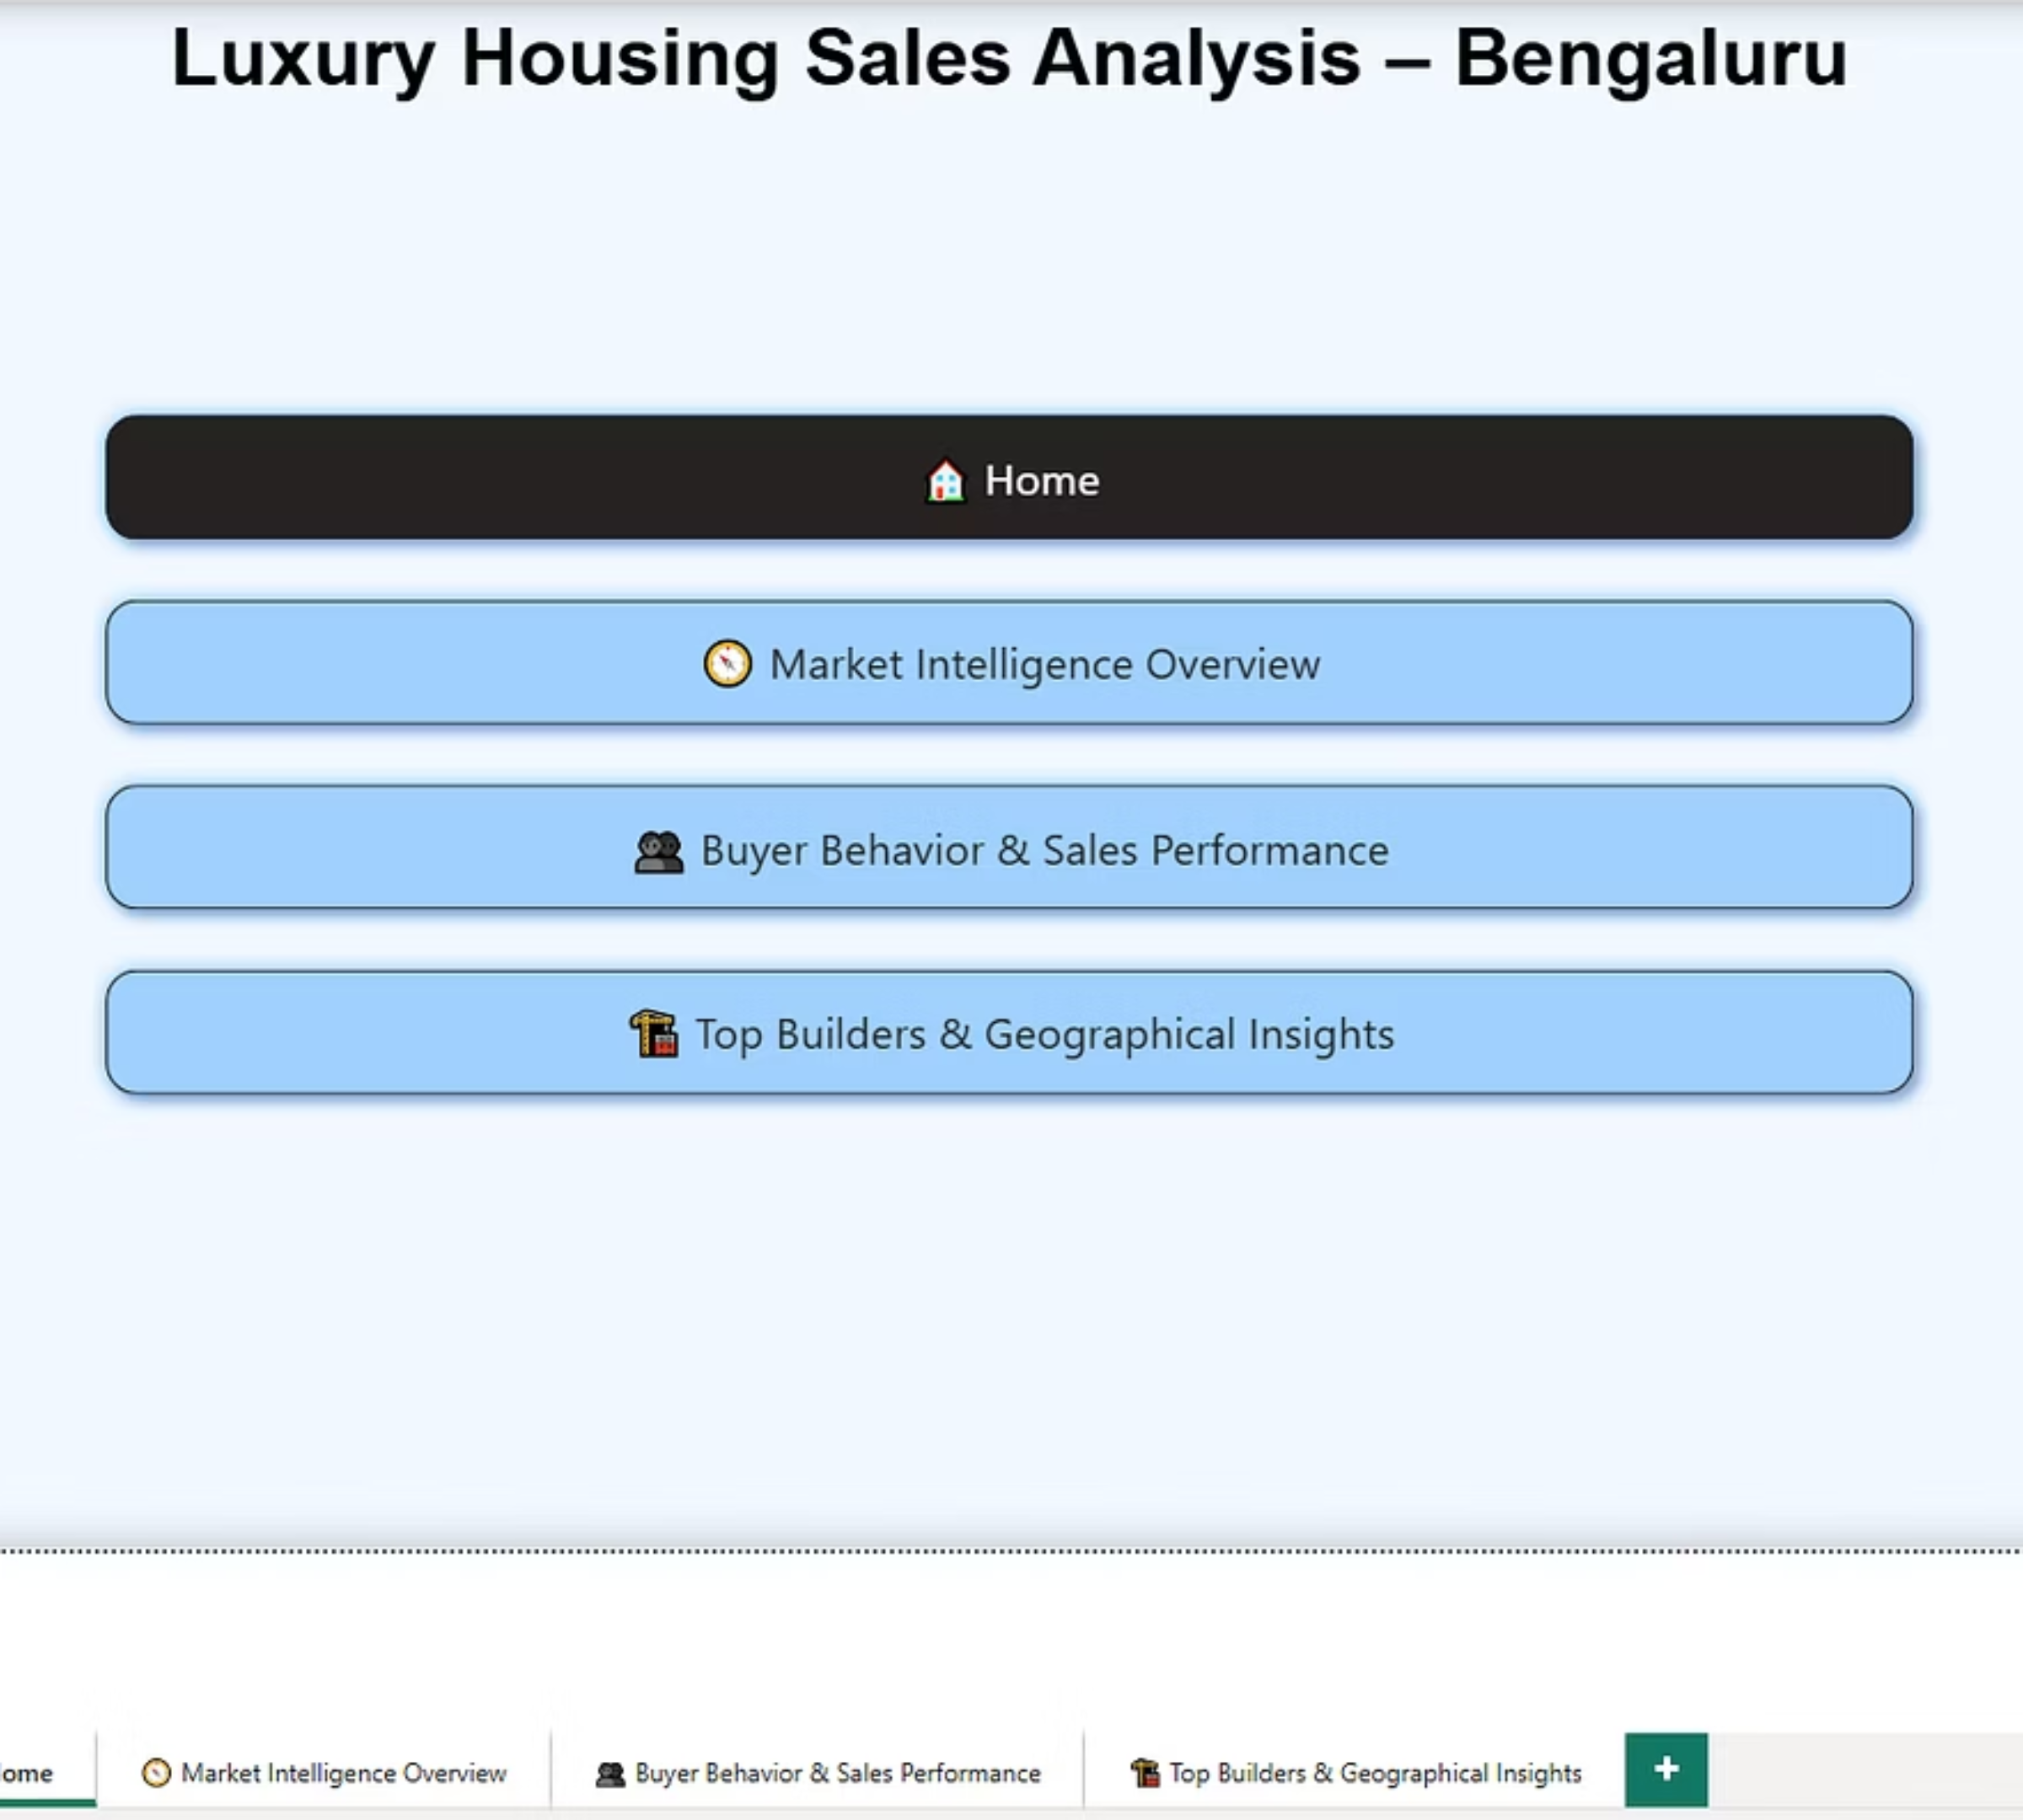
Dashboard Preview: Your Window to Market Dynamics
Our interactive Power BI dashboard provides a comprehensive, at-a-glance view of key metrics, empowering quick and informed decision-making.

Slide 4
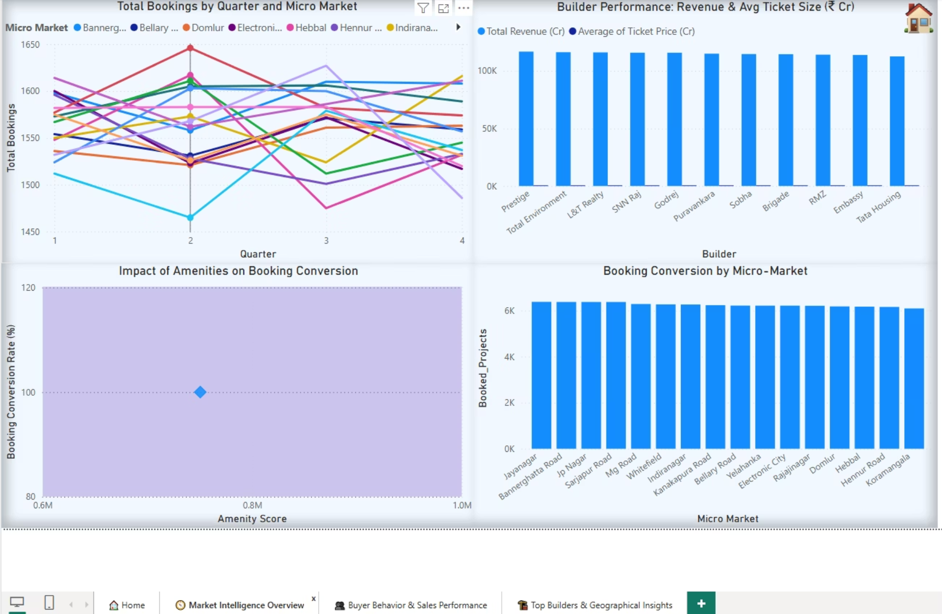
Market Intelligence: Forecasting Trends, Identifying Opportunities
Price Movement: Track average property prices and per-square-foot rates by locality.
Supply-Demand: Analyze inventory levels and absorption rates across property types.
Rental Yields: Understand investment potential based on rental income versus property value.

Slide 5
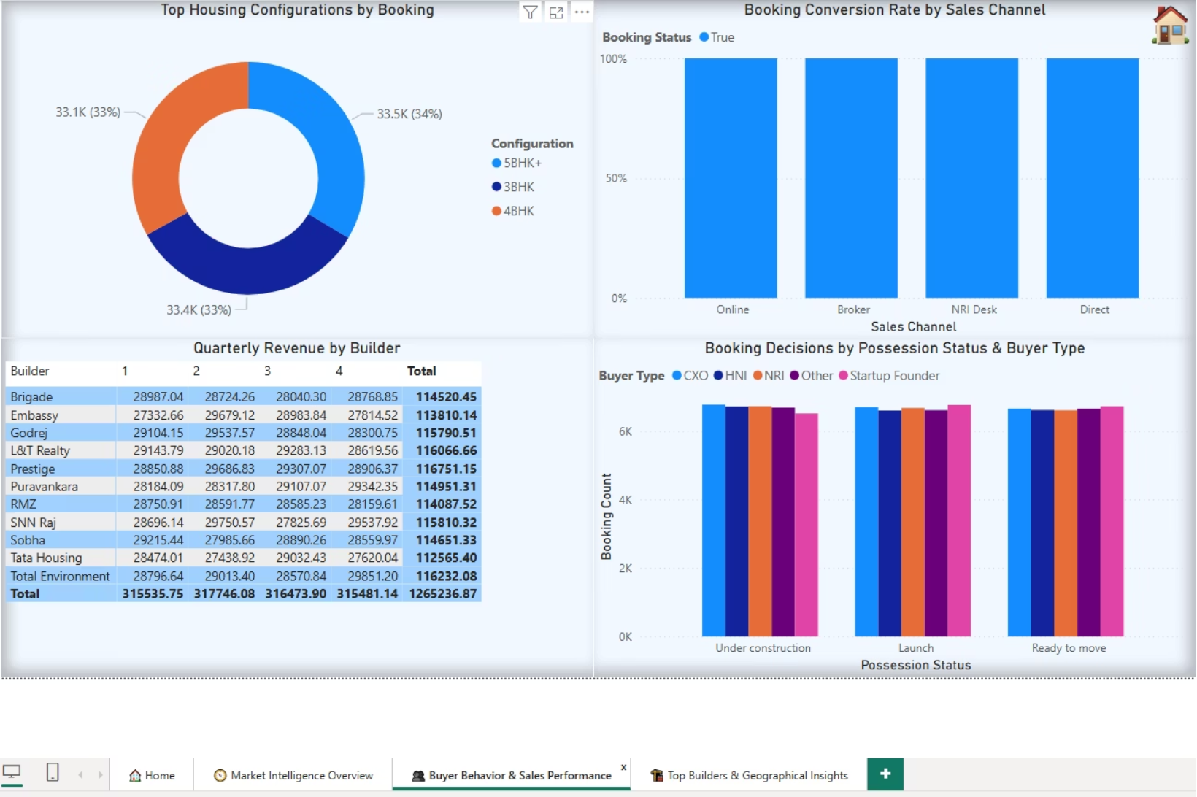
Buyer Behavior & Sales Performance Optimizing Outreach & Conversions
Understanding who is buying and how they are engaging is crucial. Our analytics reveal:
Buyer Demographics: Insights into age groups, income brackets, and preferences.
Booking Patterns: Peak times for inquiries, site visits, and final bookings.
Conversion Funnel: Identify bottlenecks in the sales process to improve efficiency.

Slide 6
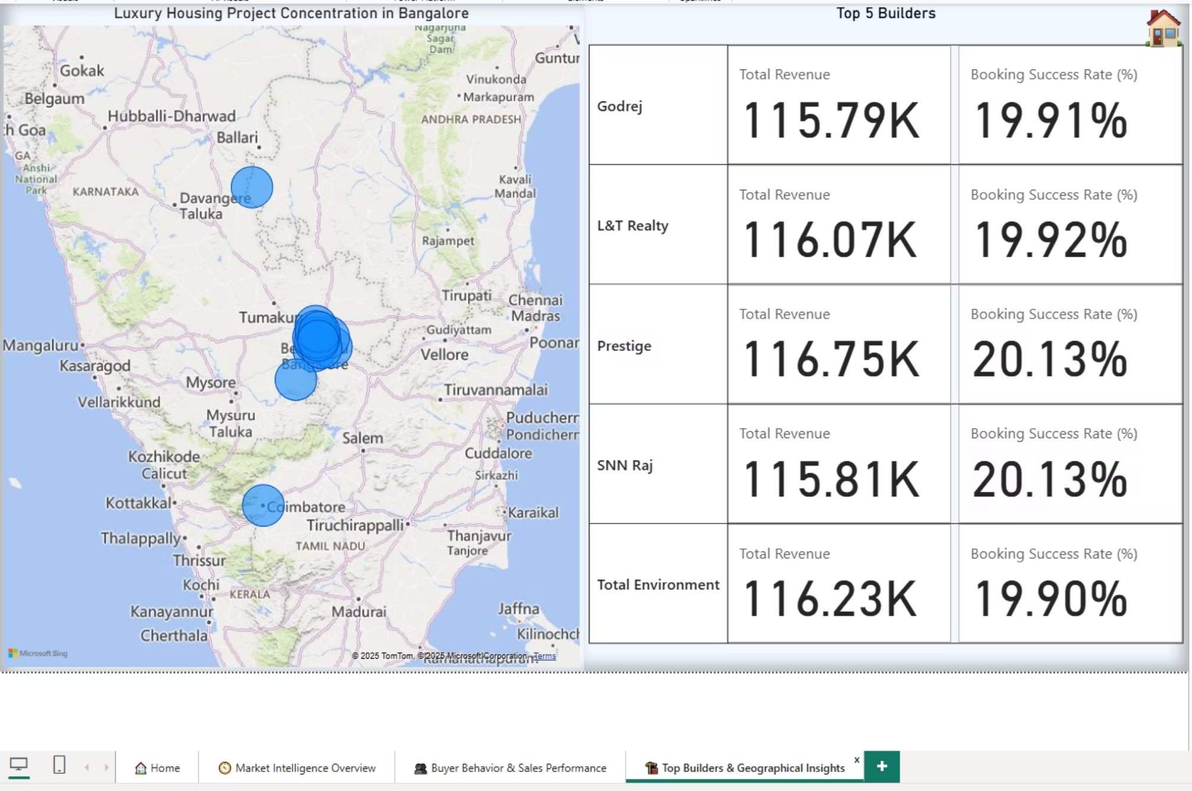
Top Builders & Geographical Insights: Pinpointing Growth Hotspots
Builder Performance: Evaluate market share, project delivery, and buyer satisfaction for leading developers.
Locality Deep-Dive: Uncover micro-market trends, average prices, and demand drivers in specific Bengaluru neighborhoods.
Amenities Analysis: Which property features (e.g., green spaces, smart home tech) command premium pricing.

Slide 7
Delivering Precision in Real Estate Analytics
01
02
03
Automated Pipeline
Actionable Intelligence
Future-Ready Capabilities
Seamless data flow from Python to SQL to Power BI for continuous, real-time insights.
Dashboards reveal market trends, buyer personas, and geographical hotspots for strategic decision-making.
This project showcases enterprise-level analytics, scalable for evolving market demands.

